Slide 1
Fake News Detection Model
Submitted To:
Asst. Prof. Md. Iqbal Quraishi
(Dept. Of Information Technology)
PRESENTED BY:
BIKASH PRAJAPATI - 10200216063 ANKAN CHATTOPADHYAY - 10200216071 OJAS VISHWAKARMA - 10200216047 SOHINI GHOSH - 10200216032

Slide 2
Table Of Contents
Overview | Part of Speech (POS) Tagging
Understanding the problems | n-grams
Project objective | Classification Algorithms Used
Target audience | Confusion Matrix - Source Code, Definitions and Comparison
Types of Fake News | Receiver Operating Characteristic Curve - Definition and Comparison
Visualization | Time Comparison of Models
Cycle Diagram | Graphical User Interface
Methodology | Project timeline
The Dataset | Conclusion
Term Frequency - Inverse Document Frequency(TF_IDF) Vectorizer | Future Prospects

Slide 3
Overview
The Cambridge dictionary defines fake news as:
“False stories that appear to be news, spread on the internet or using other media, usually
created to influence political views or as a joke.”
Fake news has been a problem from a long time. With the introduction of social media, the
spread and impact of fake news is increased and it became difficult to differentiate between
true news and fake news.
The spread of fake news is a matter of concern as it manipulates the public
opinions. The wide spread of fake news can have a huge negative impact on individuals and
society as a whole.
We developed a model which accurately determines whether an article is fake or
not using machine learning.

Slide 4
Understanding the problems
01
It has brought down the authenticity of news ecosystem as it is even more widely spread on social media than most popular authentic news.
02
Such news items may contain false and/or exaggerated claims, and may end up being viralized by algorithms, and users may end up in a filter bubble.
03
The spread of such news through social media is very rapid and can lead severe violence and gain to certain people.

Slide 5
Project objective
The major objectives of this project are:
Taking the help of linguistic cues to develop a machine learning based model for accurately determining whether the given news is fake or authentic.
To get high accuracy to determine whether a news is fake or true.

Slide 6
Target Audience
The student community that is fed with and shares most information through social networking sites. They comprise mostly tweens(age group 10-14) and juvenile teens.
Corporate employees who don’t find time from their busy work schedule to avail traditional news media.
The community that enjoys suffrage, i.e. right to vote. FIltering out fake news is a quintessential step for framing one’s political views and inclinations.
The decision-makers at the apex of administrative bodies, so that they can frame agendas as per the actual need of the day.
Notes:
Sohini verify kor ei image ta..and er nicher ta o

Slide 7
Types of Fake News
Satire or Parody - the information has the potential to fool and may be misinterpreted as fact, used to ridicule or be sarcastic
False Connection - headlines, visuals or captions that do not support the content, used to attract attention and gain profit
Misleading Content - uses information to frame an issue or an individual
False Context - includes false contextual information that is shared around genuine content
Impostor Content - derives from a false or made-up source which impersonates a real news source
Manipulated Content - genuine information or imagery but deceives to tell a different story
Fabricated Content - new and fully fabricated content that is 100% false with the intention to deceive and cause harm

Slide 8
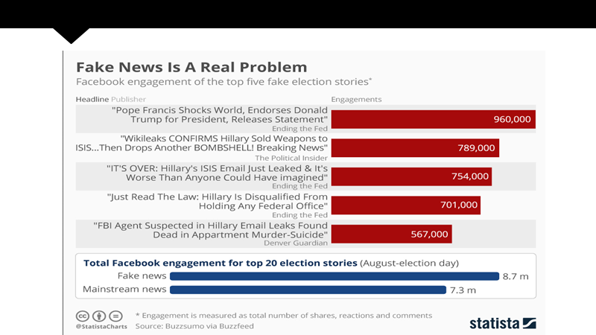

Visualization of the effect of fake news (item-wise)

Slide 9
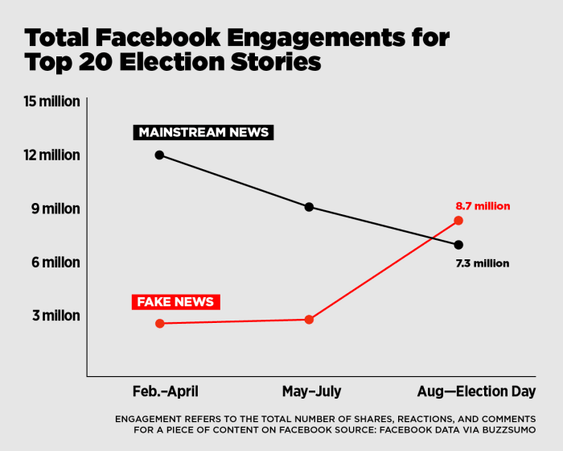
Visualization of the effect of fake news (timeline)

Slide 10
Cycle diagram
04
Refinement
Classification using algorithm
Depending upon the cumulative result, we merge with other algorithms or improvise the existing one.
An algorithm is applied to the data set to classify each item as real or fake
01
03
Study of results
Comparison
Confusion matrix is generated for the algorithm and its performance is studied
The performances of the algorithms are compared
02

Slide 11
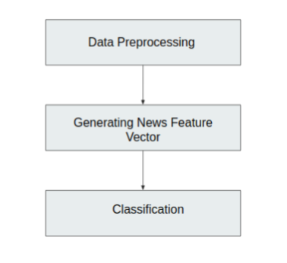
Methodology
Flowchart of Mechanism

Slide 12
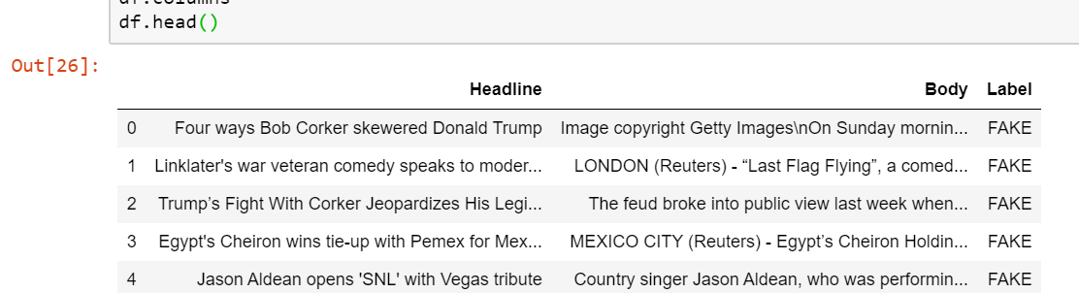
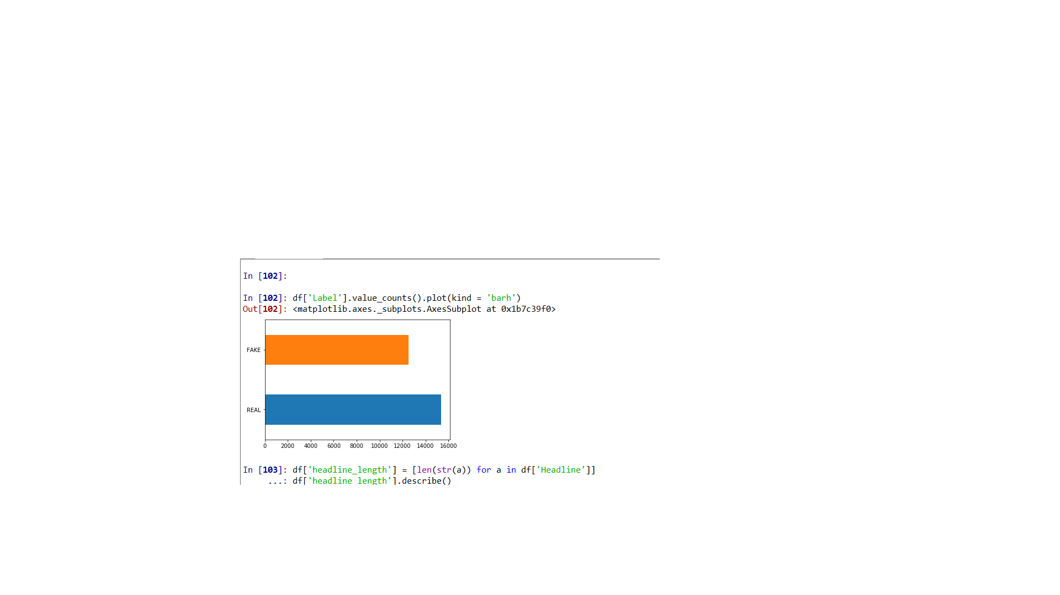
The Dataset

Slide 13
Term Frequency - Inverse Document Frequency(TF_IDF) Vectorizer
TF-IDF is a method used to represent text in a format which can be easily processed by the machine learning algorithms. It is a numerical statistic that shows how important a word is to a document in a word corpus.
TF (Term Frequency): Term frequency is deﬁned as the frequency of a word in the document. TF is calculated as: TF(w)=(Numberoftimesword‘w’appearsinthedocument)/(Totalnumber of words in the document).
IDF (Inverse Document Frequency): This measures how important a word is in the document. For example, words like and, of, the, a appears lot of times but they are less important. Thus most repeated terms are given less weights and less frequent terms are given more weights. IDF is calculated as: IDF(w) = loge(Total number of documents / Number of documents with word ‘w’ in it).

Slide 14
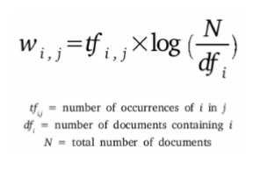
TF-IDF continued...
The TF-IDF weight is given to each word by calculating TF*IDF values.
Formula for TF-IDF

Slide 15
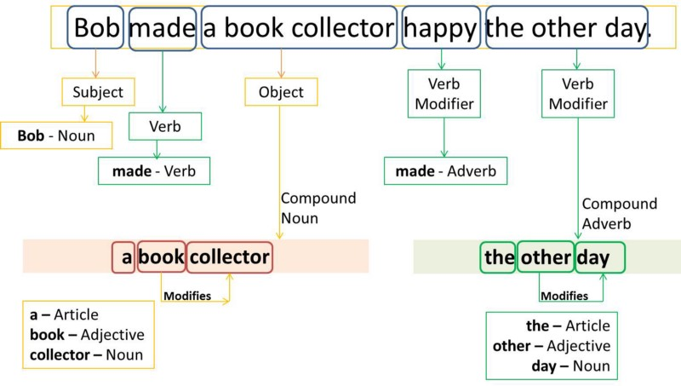
Part of Speech (POS) Tagging
The text is read in some language and parts of speech are assigned to each word (and other token), such as noun, verb, adjective, etc., although generally computational applications use more fine-grained POS tags like 'noun-plural'.
Example of POS tagging

Slide 16
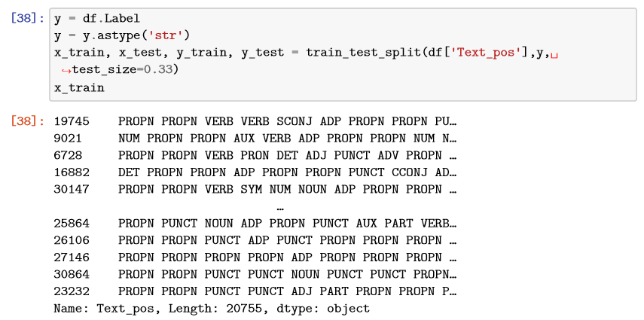
Dataset after POS Tagging

Slide 17
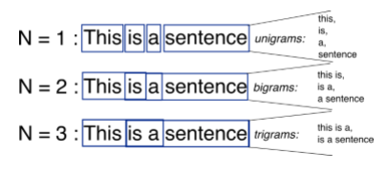
n-grams
n-gram is a contiguous sequence of n terms from a given text. An n-gram of size 1 is referred to as a "unigram"; size 2 is a "bigram", size 3 as a "trigram" and so on. with larger n, a model can store more context.
Example of n-grams
For generating the news vector, we calculate the tf-idf values of the bigrams and represent the tf-idf vector of that bigrams. We choose bigrams over unigrams because it gives the context.

Slide 18
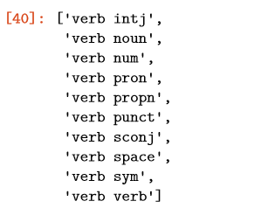
POS tagged bigrams

Slide 19
Classification Algorithms Used
After generating the news feature vector, now we classify the vector to whether it is fake or real. We aim to use the following classiﬁcation algorithms for the purpose of classiﬁcation.

Slide 20
Random Forests
Random Forests is a bagging type of ensemble model in which the base model for bagging is decision tree. In addition to bagging (i.e taking random samples of total data and train those samples independently and then take the majority voting of numerous samples of the total dataset to ﬁnd the output of the total dataset), there is feature bagging (i.e column sampling in which not all the columns/features are taken into consideration while training but rather random samples of features are considered while training diﬀerent samples.
Random Forest = Bagging with decision tree as base model + feature bagging

Slide 21
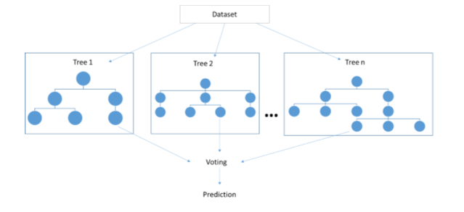
Mechanism of Random Forest

Slide 22
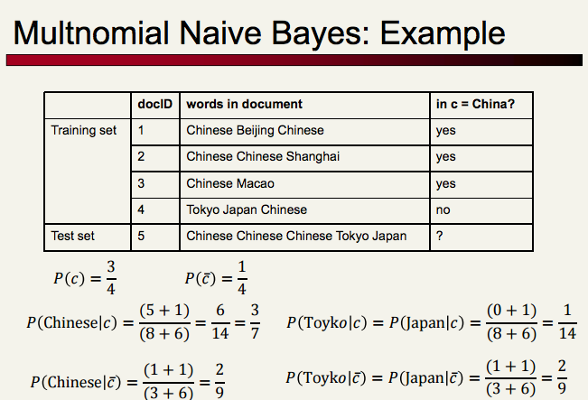
Naive-Bayes
Naive Bayes is a supervised learning algorithm which is used for classiﬁcation. It is based on bayes theorem assuming that features are independent of each other. It calculates the probability of every class, the class with maximum probability is chosen as the output.

Slide 23
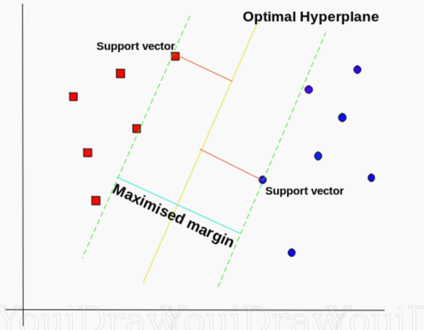
Support Vector Machine
An SVM model is a representation of the data points in space, mapped so that the samples of the separate categories are divided by a clear gap that is as wide as possible.

Slide 24
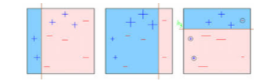
Gradient Boosting
Gradient boosting is an example of boosting ensemble model. Boosting is an ensemble technique in which the predictors are not made independently, but sequentially. Boosting tries to convert a weak learner to become better. It learns from its mistakes/error and tries to reduce the error.
Example of Gradient Boosting

Slide 25
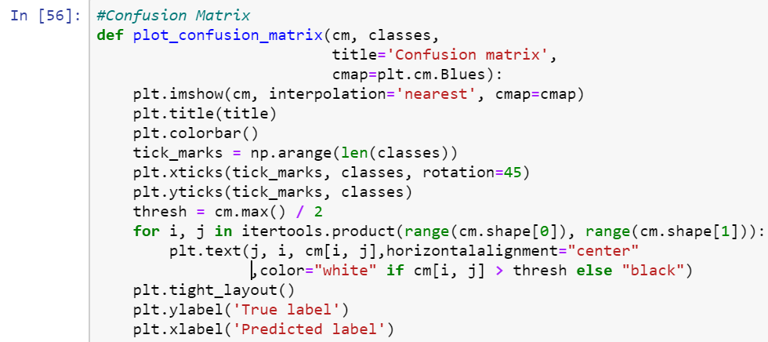
Source Code for Confusion Matrix

Slide 26
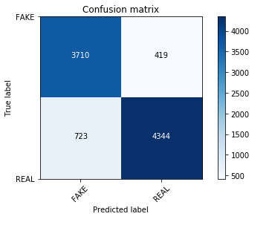
Definitions related to Confusion Matrix
True Positives (TP): These are cases in which we predicted yes (the news is REAL), and it is indeed REAL. It is shown by box with number 4344. True Negatives (TN): These are cases in which we predicted no (the news is FAKE), and it is indeed FAKE. It is shown by box with number 3710.
False Positives (FP): We predicted yes (REAL), but it is actually FAKE. (Also known as a "Type I error.") It is shown by box with number 419.
False Negatives (FN): We predicted no (FAKE), but it is actually REAL. (Also known as a "Type II error.") It is shown by box with number 723.

Slide 27
Definitions continued...
False Positive Rate: The false positive rate is calculated as FP/(FP+TN), where FP is the number of false positives and TN is the number of true negatives (FP+TN being the total number of negatives). It’s the probability that a false alarm will be raised: that a positive result will be given when the true value is negative.
True Positive Rate: The true positive rate (TPR, also called sensitivity) is calculated as TP/(TP+FN), where TP is the number of true positives and FN is the number of false negatives (TP+FN being the total number of positives). It is the probability that an actual positive will test positive.

Slide 28
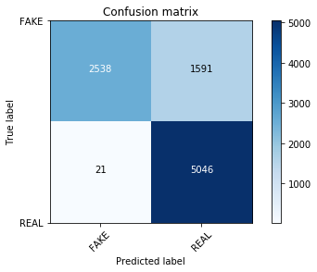
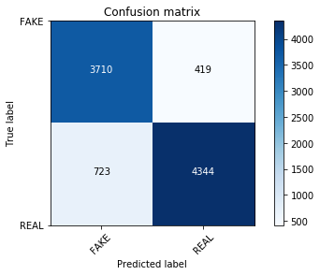
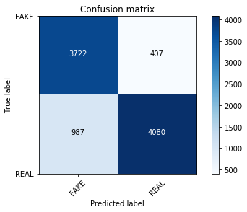
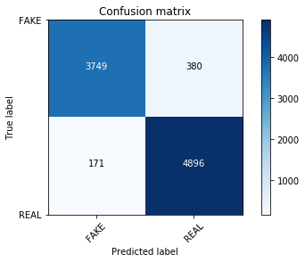
Comparison of algorithms(Confusion matrix)
Part- I
<- Multinomial Naive Bayes
Accuracy - 82.5%
Random Forest ->
Accuracy - 87.6%
<- Gradient Boosting
Accuracy -84.8%
Support Vector Machine ->
Accuracy - 94.2%

Slide 29

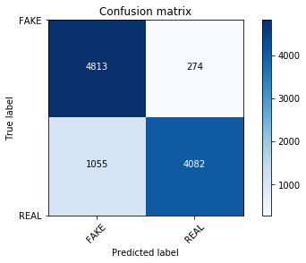
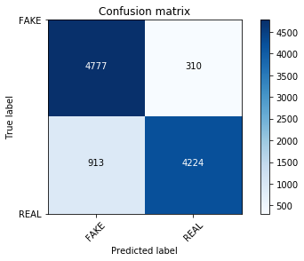

Comparison of algorithms(Confusion matrix)
Part- II
<- Multinomial Naive Bayes
Accuracy - 79.5%
Random Forest ->
Accuracy - 87%
<- Gradient Boosting
Accuracy - 88%
Support Vector Machine ->
Accuracy - 83.6%

Slide 30
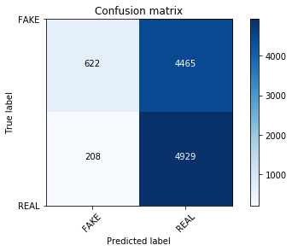
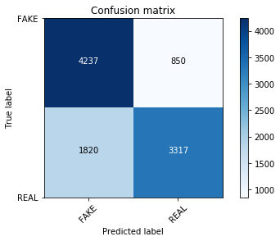


Comparison of algorithms(Confusion matrix)
Part- III
<- Multinomial Naive Bayes
Accuracy - 54.3%
Random Forest ->
Accuracy - 73.9%
<- Gradient Boosting
Accuracy - 87.9%
Support Vector Machine ->
Accuracy - 82.9%

Slide 31
Receiver Operating Characteristic Curve
A receiver operating characteristic curve, or ROC curve, is a graphical plot that illustrates the diagnostic ability of a binary classifier system as its discrimination threshold is varied.
In a ROC curve the true positive rate or Sensitivity (y-axis) is plotted against the false positive rate or 100-Specificity (x-axis) for different cut-off points of a parameter. The area under the ROC curve ( AUC ) is a measure of how well a parameter can distinguish between two prediction groups (REAL/FAKE).

Slide 32
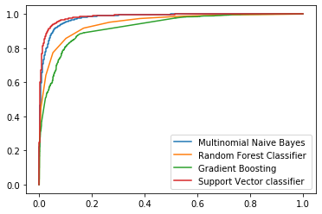
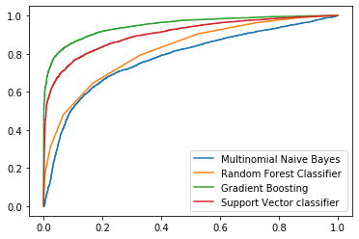
ROC Curves for all the classifications

Slide 33
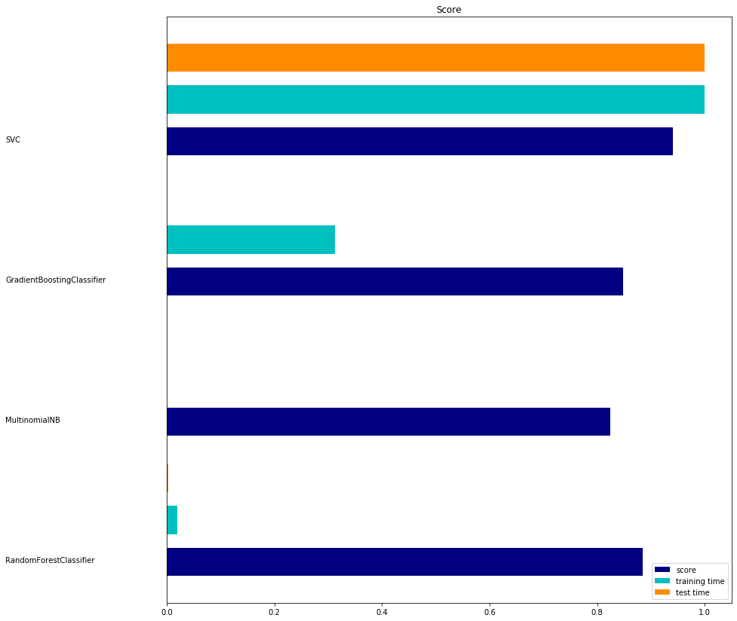
Time Comparison (TF-IDF Vectorizer)

Slide 34
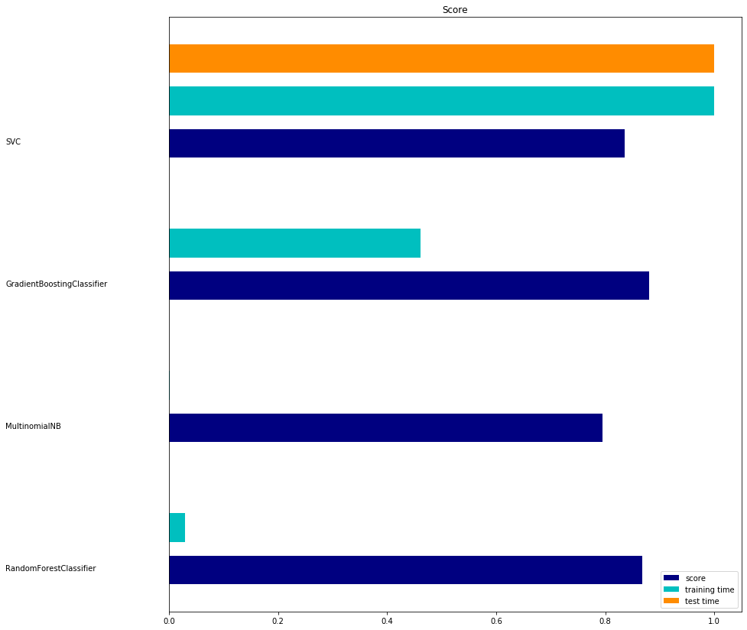
Time Comparison (After Natural Language Processing)

Slide 35
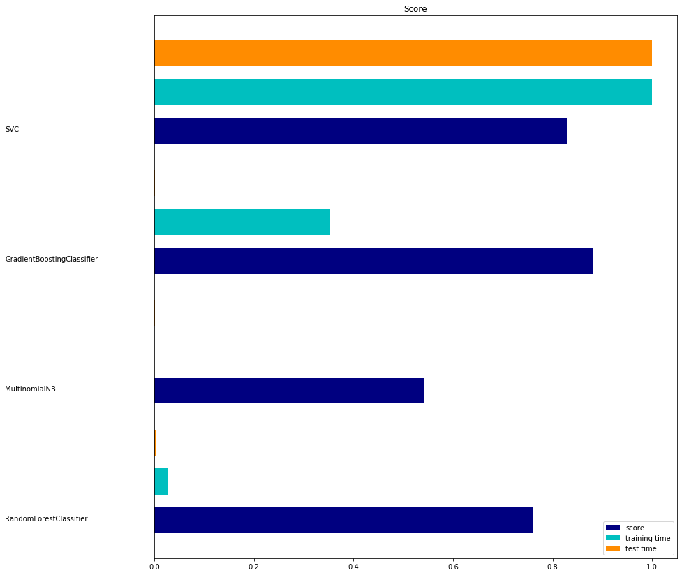
Time Comparison (Merging the two models)

Slide 36
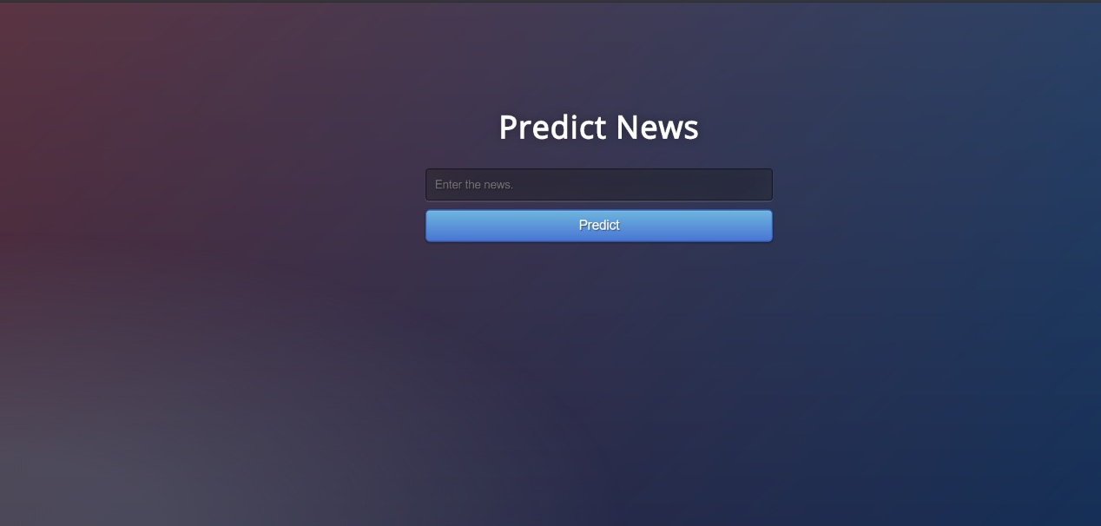
Graphical User Interface

Slide 37
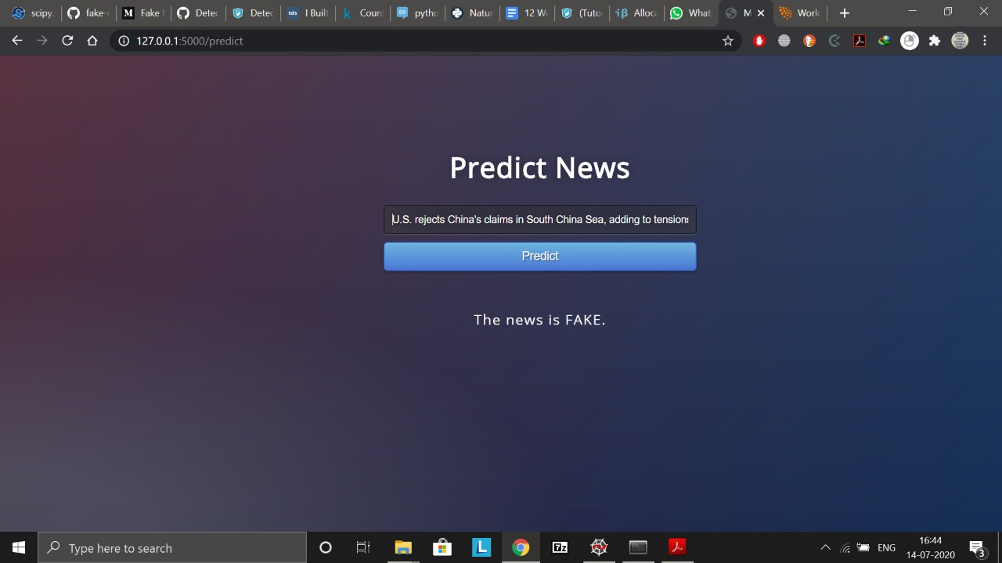

Slide 38
Project timeline
JUL-AUG ‘19
SEPT -OCT ‘19
NOV-DEC ‘19
JAN-FEB ‘20
MAR-APR ‘20
MAY-JUN ‘20
EXPERIMENTATION
PLAN OF ACTION
RESEARCH STUDY
IMPLEMENTATION
REFINEMENT
ENHANCEMENT
Choosing a problem that is persisting for a long time and needs modern solution..
Scrutinizing various case studies and figuring out probable solutions
Gathered various datasets and learnt various trends in the data. Trained 2 different models and compared their accuracy.
Text Processing and testing models on extraneous data.
Trying out various ways to improve accuracy by implementing 10 more models.
Introducing illustrative graph plots for better understanding and creating GUI

Slide 39
Conclusion
From the three approaches used,
We can see that Gradient Boosting has performed best in two of the three cases we applied, with 88% and 87.9% accuracy. It is also clear from the accuracy percentage, that Gradient Boosting algorithm has been the most consistent one in differentiating the real and fake news, which is also a major deciding factor in detecting fake news.
Therefore, we can deduce from the approaches used, that Gradient Boosting algorithm with Natural Language Processing is the best fit for our project to differentiate real and fake news. And hence we select it as the final model to detect fake news.

Slide 40
Future Prospects
Involving advanced elements of semantic analysis for better extraction of linguistic cues.
Introducing sentiment analysis for better discourse analysis.
Using better techniques of feature engineering for optimized data preparation upon availability of faster hardware resources.
Accepting feedback from users who might rely on multiple fact checkers to verify information, as to whether the prediction is correct. This feedback can be used to increase the training data size and hence obtain a better fitting model.
Tracing the origin of generation of fake news so that it can be used in cyber governance.
Incorporate facilities for live detection and analysing more languages.

Slide 41
Thank you!

